Slide 1
JENKINS MASTER AND SLAVE CONFIGURATION
BY:- MOHAMMED AFZAL

Slide 2
JENKINS:- The leading open source automation server, Jenkins provides hundreds of plugins to support building, deploying and automating any project.Jenkins is used to build and test your software projects continuously making it easier for developers to integrate changes to the project, and making it easier for users to obtain a fresh build.
What is Jenkins? Jenkins is an open-source automation tool for Continuous Integration (CI) and Continuous Deployment (CD).
DevOps is a software development concept and revolves around the various phases like continuous development, continuous testing, continuous integration, continuous deployment and continuous monitoring throughout the life cycle.
Jenkins is the most effective tool for implementing automation testing in CI/CD pipelines.

Slide 3
What is CI vs CD?
CI focuses on preparing code for release (build/test), whereas CD involves the actual release of code (release/deploy)
JENKINS MASTER AND SLAVE CONFIGURATION
Jenkins is an awesome Continuous Integration tool which allows you to add multiple slaves as per your project requirement to a central Master server.
In distributed environment, we need different machines for different purposes. For example, we may need machine1(Ubuntu) to run some process and machine2(CentOS) to run some other process. For such distribution, Jenkins Master Slave configuration comes to the rescue.

Slide 4
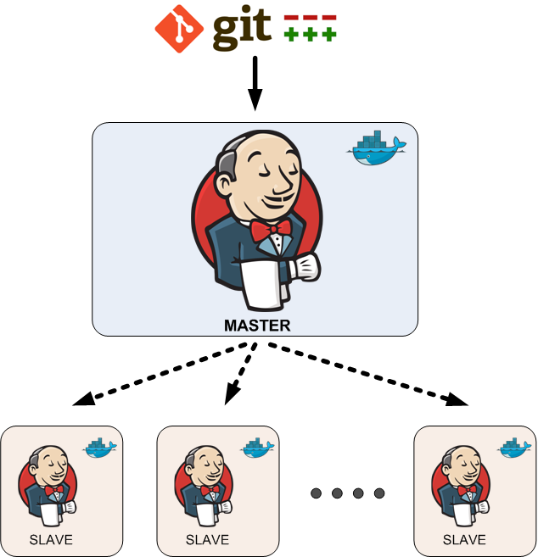

Slide 5
PRE-REQUISITES:-
AWS Account
EC2 Instance
Jenkins Server
Create EC2 Instance for master server (kernal version + t2.medium + 16gb storage) and another EC2 Instance for Slave server(kernal + t2.medium). Connect to the instances.
Install Jenkins in master server by executing Jenkins installations commands and setup Jenkins server.

Slide 6
SLAVE NODE CONFIGURATION
Create a new user, SSH key and copy the key into Authorized_keys.
PROCEDURE:-
Update the instance .
Install java in machine.
Create a new user and add password to that user.
Switch to the New user (slave).
Generate a new key in the user.
Copy public key id_rsa.pub in new file with name authorized_keys.
Change the permission authorized_keys file i.e., give all permissions to the user.

Slide 7
MASTER SERVER CONFIGURATION
Copy the slave node public key to master node’s known_hosts.
PROCEDURE:-
Create a .ssh directory in path /var/lib/Jenkins/.ssh.
Go to the .ssh directory.
Change the permissions of .ssh directory i.e., give all permissions to users, group and others.
copy the public key(id_rsa.pub) of slave node to known_hosts.
Change the ownership known_hosts from ec2-user to Jenkins.
Change the permissions of known_hosts i.e., give all permissions to user only.

Slide 8
ATTACHING SLAVE NODE TO MASTER SERVER
Attaching Slaver server with a master server.
PROCEDURE:-
Go to Jenkins server.
Click Manage Jenkins option in Dashboard.
Click on Manage Nodes and Cloud and then click on New Node.
Enter the node name and select permanent agent and click ok.
Enter the Node configuration such description, label name, number of executors, credentials, remote root directory etc, While adding credentials choose kind as SSH username with private key and provide user name and private key which is generated in slave user.
Click on the save option and check in the log whether the slave server is online or offline

Slide 9
RUNNING A JOB SLAVE SERVER
PROCEDURE: -
Login to Jenkins server.
Create a new task by providing name and descriptions.
Select “Restrict where this project can be run” option and provide label Name in “ Label Expression” to select the slave.
Select Git as “Source Code Repository”.
Provide Project repo URL with credentials.
Select Execute Shell in Build Steps and provide execution command to run the project.
Click Apply and Save option.
After providing all project configuration build the project by selecting “Build Now”.

Slide 10
THANK YOU

